Slide 1
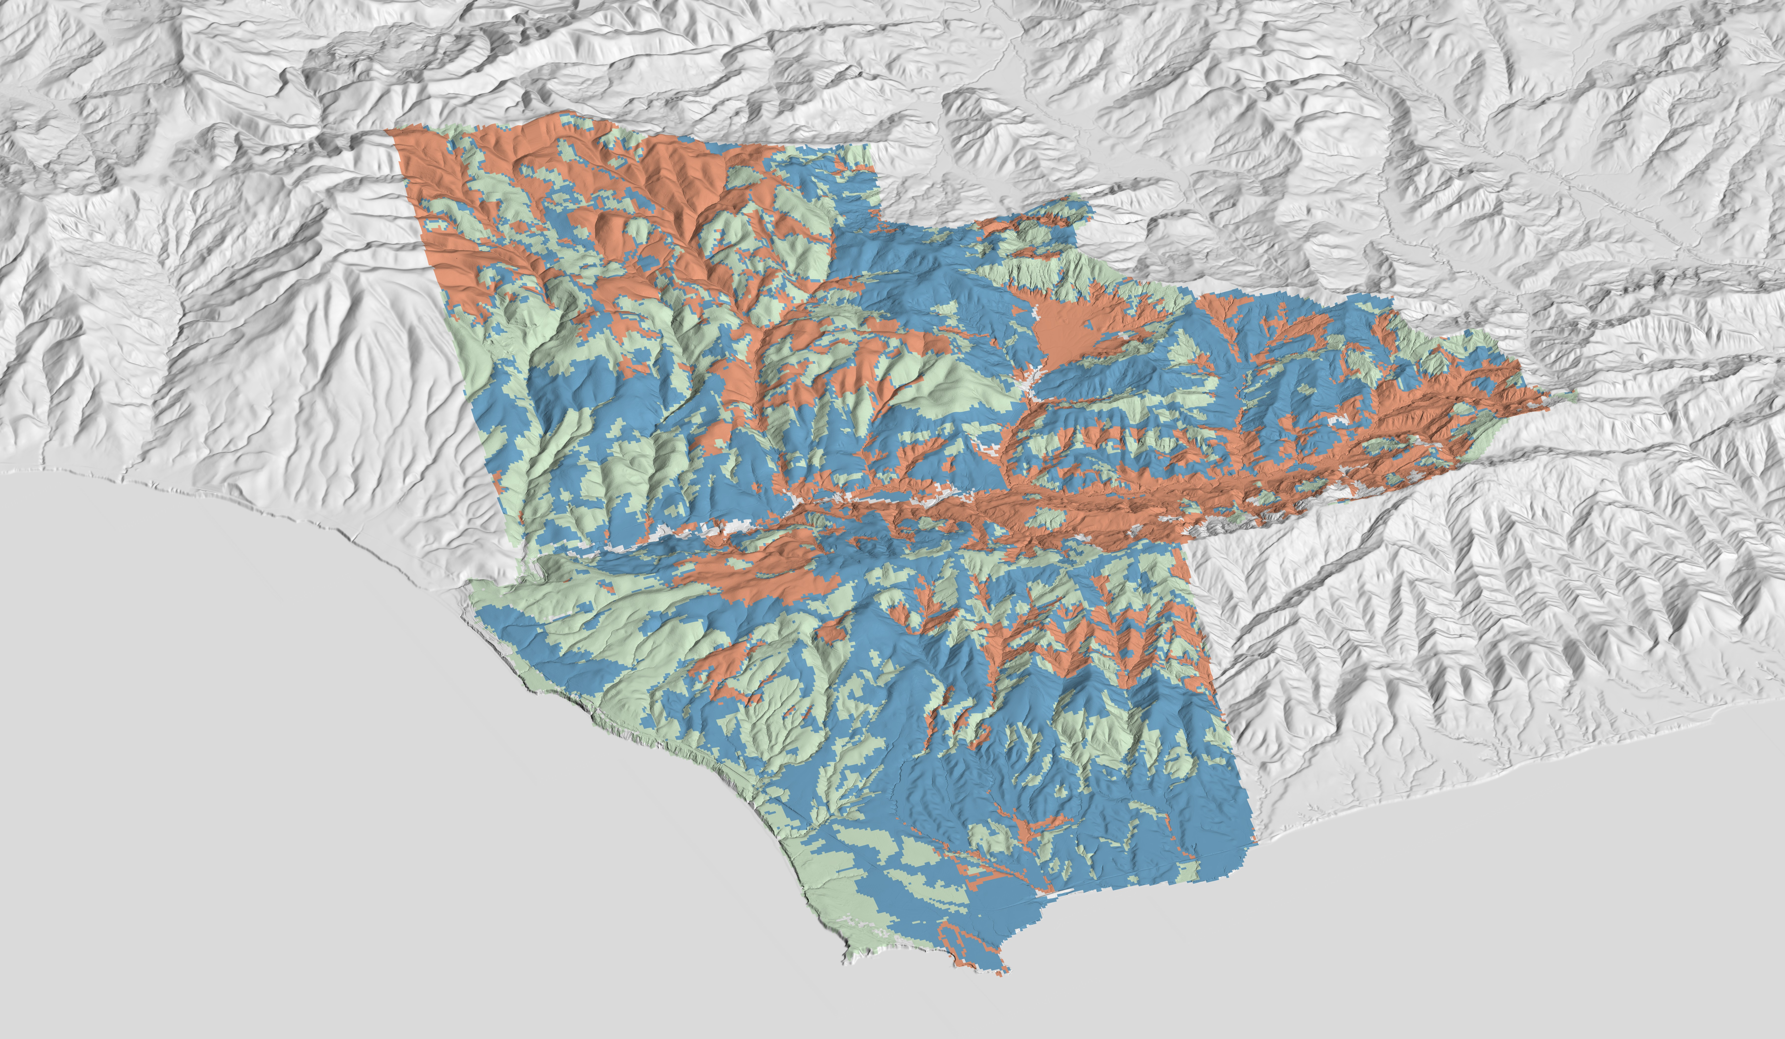
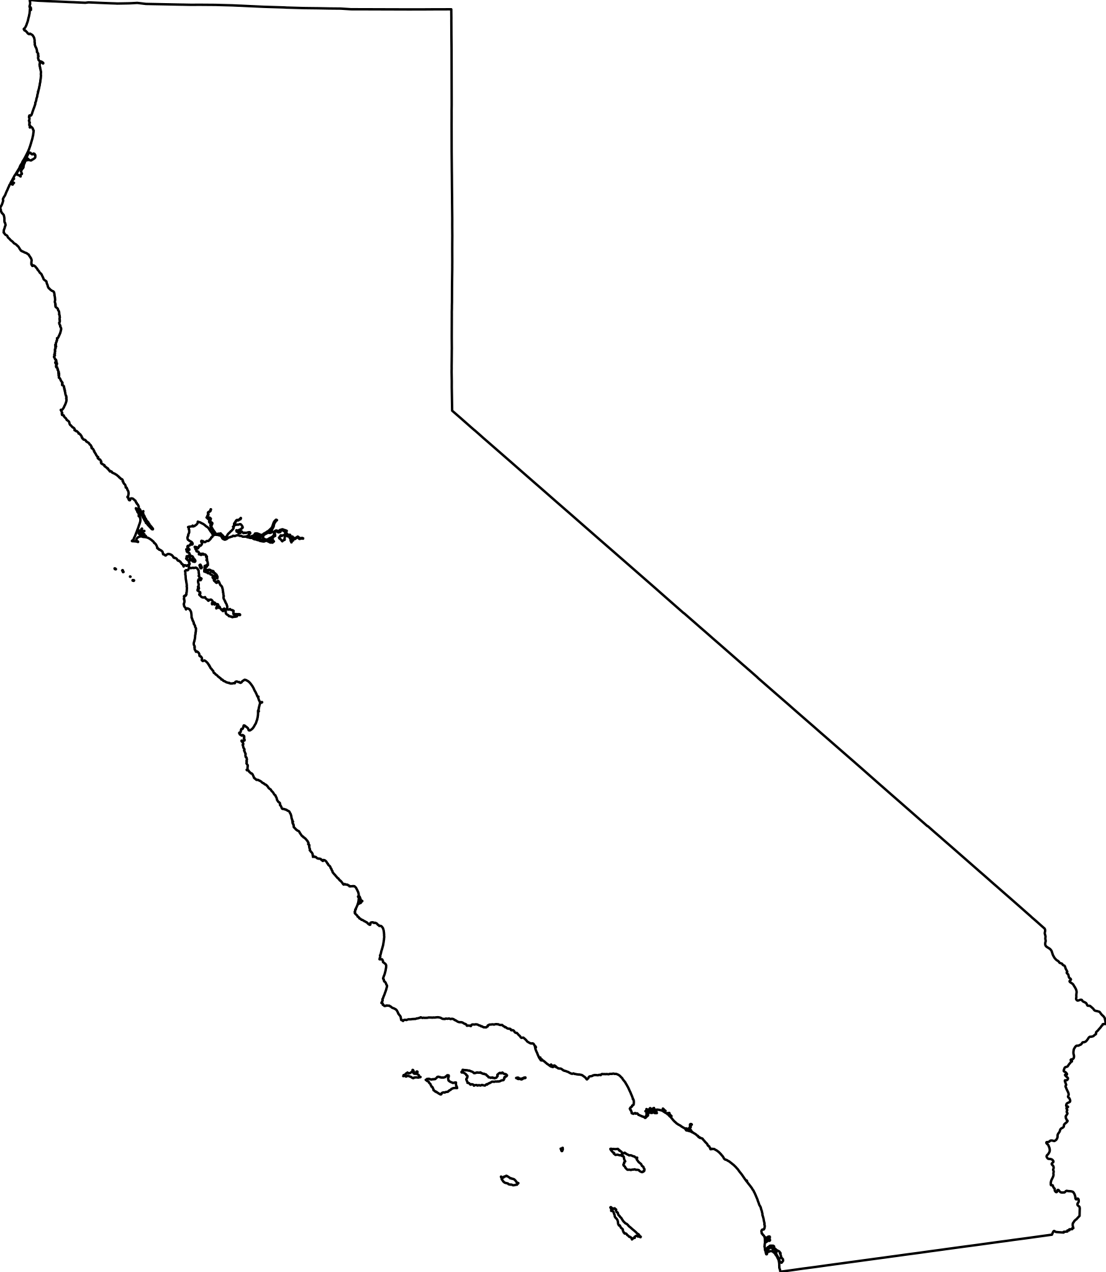
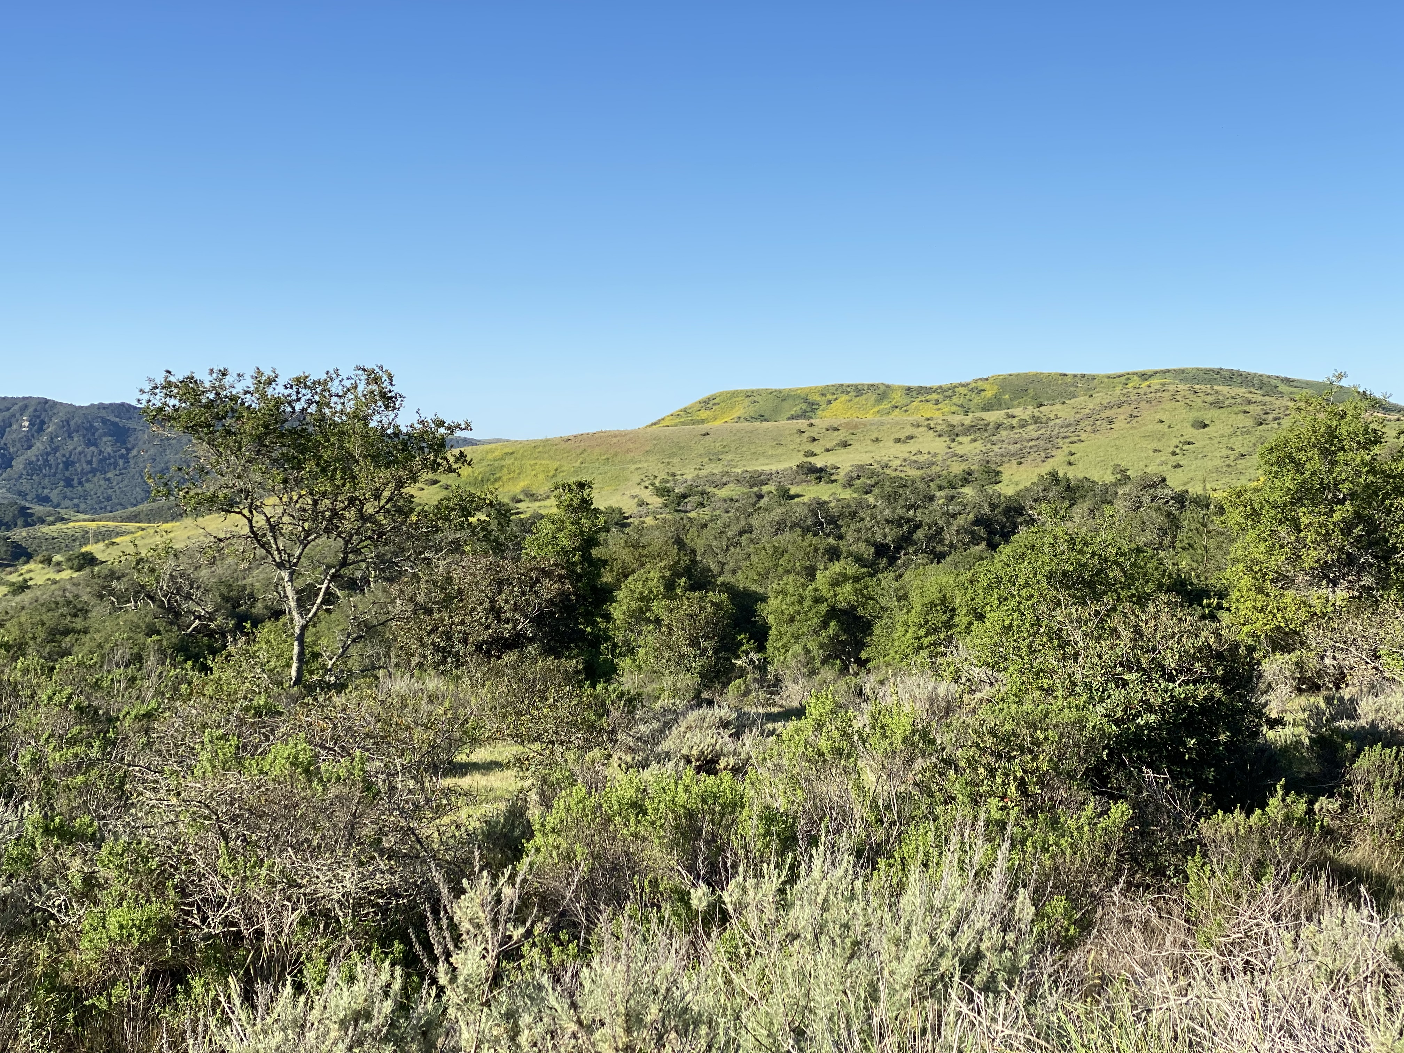
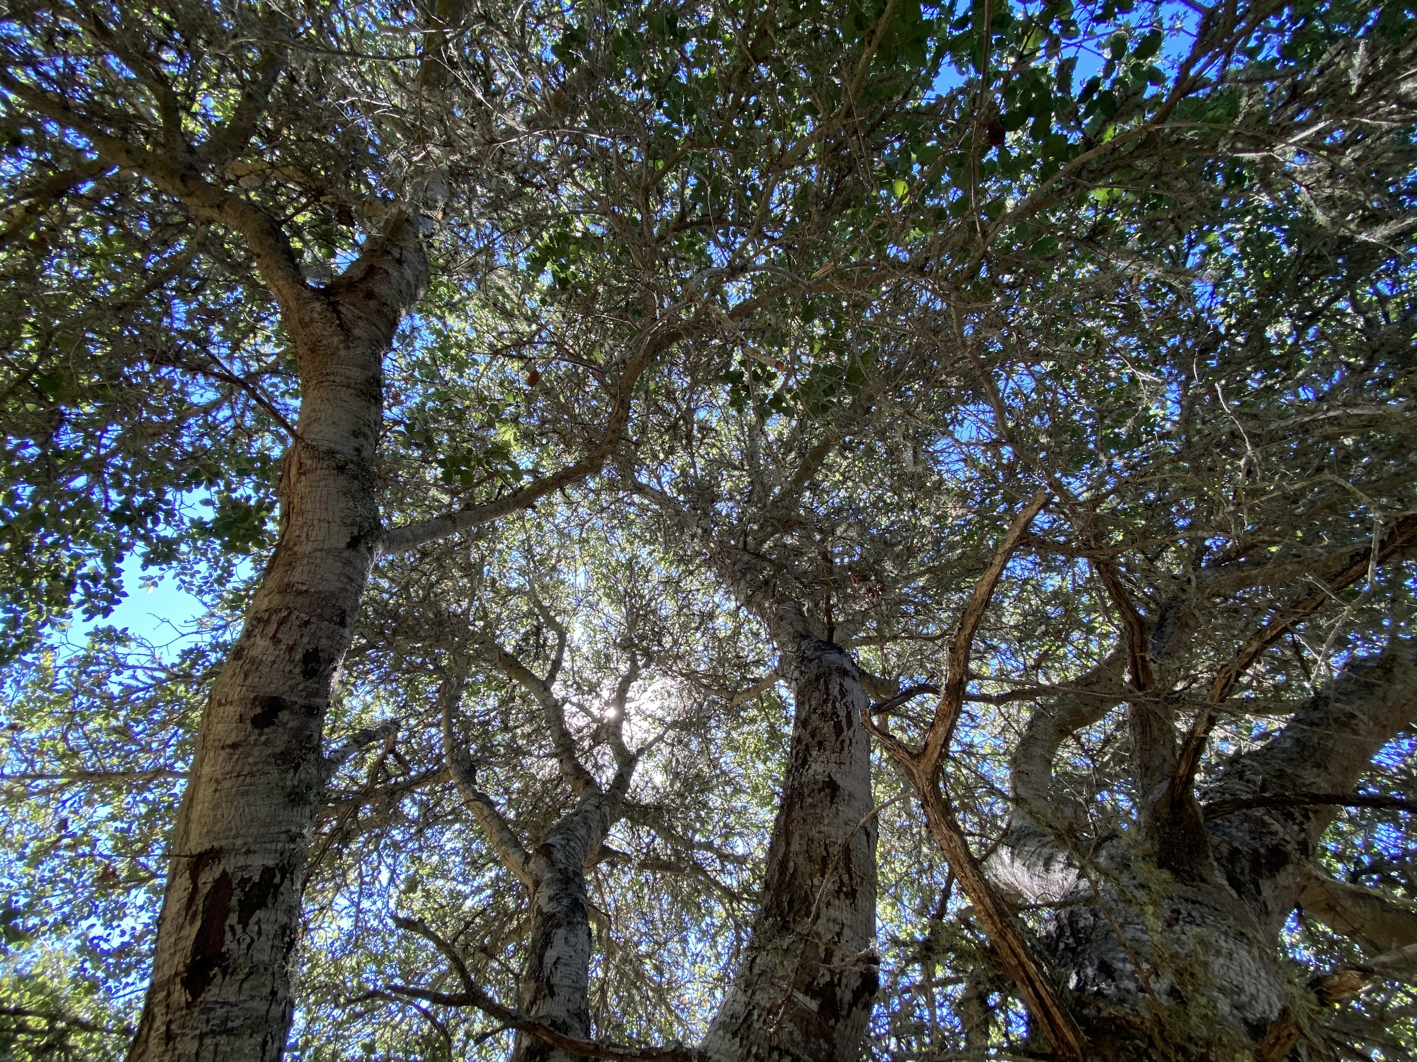
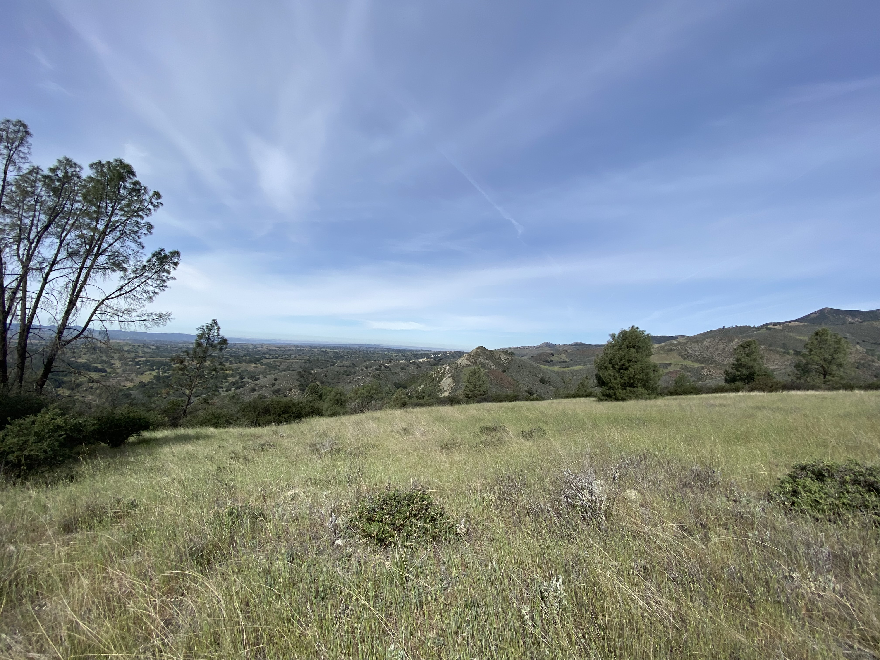
California
S a n t a Y n e z M o u n t a i n s
J a l a m a C r e e k
N
0
0.5
1km
Coastal Scrub
Annual Grassland
Coastal Oak Woodland
Point Conception
33%
38%
29%

